Slide 1
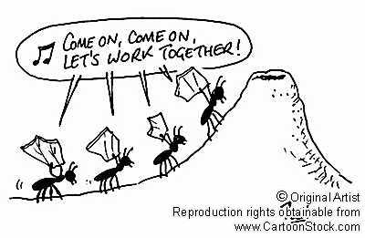
Building an Effective TEAM

Slide 2

TEAM Vs GROUP
The key distinguishing factor –
MISSION / PURPOSE / GOAL
Success of a Team depends upon Clear, Compelling, Outcome based Goals rather than Activity Goals
Teams CANNOT succeed without a SHARED PURPOSE
Teams are more productive than groups because members are committed to deliver tangible performance results.
Notes:
Activity –
Develop a plan for improving customer satisfaction
Make third quarter budgets
Outcome
Eliminate all late deliveries to customers within 90 days

Slide 3
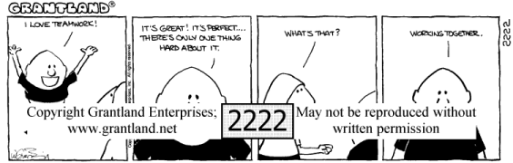
Purpose & Performance Goals
Each one of us has our unique qualities and differ in opinion. A TEAM can only be formed when we Transcend these differences for realizing our common PURPOSE.
A common set of demanding Performance Goals and not the feeling of working together makes a Group become a Team.
Teams are more about Discipline than Togetherness.
PERFORMANCE is the Primary Objective while a Team is a means, not the end.
Notes:
Estimation of project time line – goofed up many times – need to detail out activities for better resource planning
Unable to do the important thing first – not understood importance of current moment and make choice – it may not be possible to always do everything at the same time
Minor errors repeating, lack to complete testing each time, - could have saved time and one more
ASP .Net and XML are all in theory – no actual implementation
VRV site still static and not even a single line changed in the whole year.
SOS stands as it is – payment gateway not tested, CCM changes not finalized / completed, Online HR Integration with Infoman HRM
Reason – too much focus on the job at hand without keeping the overall goal in mind.
International market – withya case and jain publishing

Slide 4
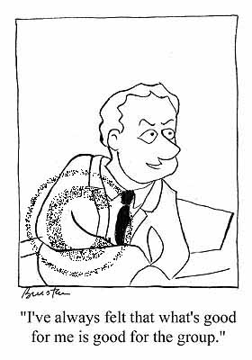
Becoming a TEAM
Groups become Teams through
Disciplined Action. They Shape a
Common Purpose, Agree on Performance Goals, Define a Common Working Approach, Develop high levels of Complementary Skills, and hold themselves Mutually Accountable for Results.
And, as with any Effective Discipline, they NEVER STOP DOING any of these things.

Slide 5
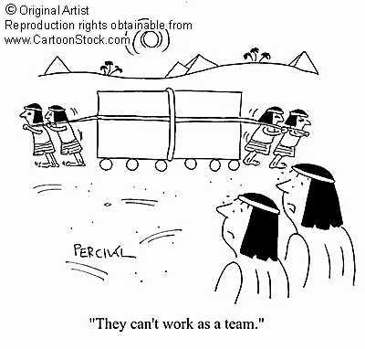

Re-looking at our MISSION
“We consistently deliver high quality products, services and solutions to our customers, and strive
to exceed customer
expectations through
continuous
process improvement”.
Notes:
In smallest of tasks we perform
With each customer interaction
Internal Documentation & Communication
Take Individual Initiative at all stages of Project Development

Slide 6
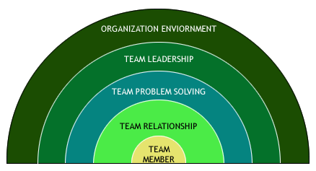
Dynamics of TEAMS
Building successful teams depends on –
  Behavior of individual members
  Dimensions, strengths & weaknesses of working relationships
  Behavior of teams that make them successful at problem solving
  Behavior of team leaders as seen by the team members
  Organizational processes and practices that lay ground for success of teams.

Slide 7
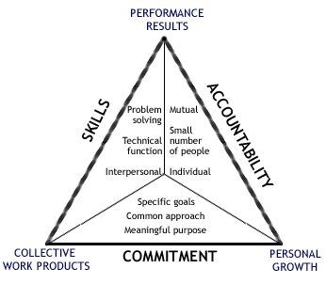
TEAM Basics

Slide 8
TEAM Effectiveness
CLEAR ROLES AND RESPONSIBILITIES
CLEAR
Mission
Purpose
Values
Goals
CLEAR PROCEDURES
POSITIVE RELATIONSHIPS
STRONG LEADERSHIP

Slide 9
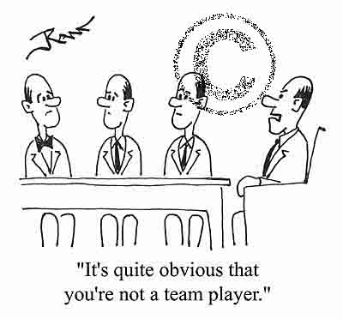
Becoming a Good Team Member
A successful team begins with the right people and we all can acquire the skills and develop the will to be an effective member.
Working Knowledge Factors
Team Factors
Skill Experience
Openness
Supportiveness
Problem solving
Ability
Personal Style
Action Orientation

Slide 10
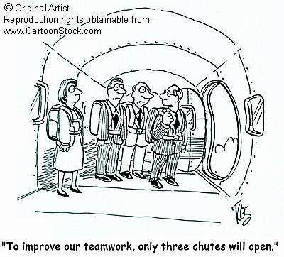
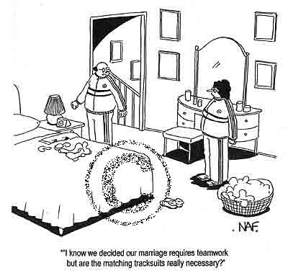
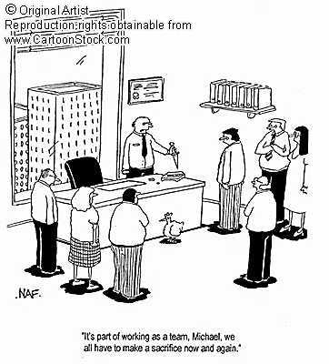
Game Time

Slide 11

THANK YOU
LETS STRIVE to
BUILD EFFICIENT TEAMS

